Slide 1

Mathematical Foundations for Data Science
MFDS Team

Slide 2
DSECL ZC416, MFDS
Lecture No. 5

Slide 3
Agenda
Recapitulation of concepts on Eva, Eve
Eva, Eve of special matrices
Similarity transformation
Diagonalization of matrices
Numerical method for Eva, Eve

Slide 4
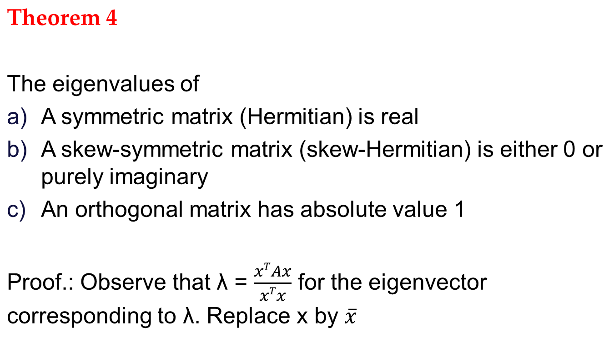
Eigenvalue properties

Slide 5
Eigenvectors
Theorem 5
Let A be a n x n matrix having distinct eigenvalues λ₁, λ₂, λ₃,…,λ_{n} then the eigenvectors corresponding to these eigenvalues are linearly independent.
That is then A has a basis of eigenvectors x₁, … , x_{n} for R^{n}.
Proof: Constructive.

Slide 6
Eigenvectors corresponding to Distinct Eigenvalues are Linearly Independent
Let k be the smallest positive integer such that v₁, v₂, . . . , v_{k} are linearly independent. If k = p, nothing is to be proved.
If k < p, then v_{k+1} is a linear combination of v₁, . . . , v_{k}; that is, there exist constants c₁,c₂,...,c_{k} such that
v_{k+1} =c₁v₁ +c₂v₂ +···+c_{k}v_{k}.
Applying the matrix A to both sides, we have
Av_{k+1} = λ_{k+1} v_{k+1}
= λ_{k+1} (c₁v₁ +c₂v₂ +···+c_{k}v_{k})
= c₁λ_{k}+1v₁ + c₂λ_{k}+1v₂ + · · · + c_{k}λ_{k}+1v_{k};
Av_{k+1} = A(c₁v₁ +c₂v₂ +···+c_{k}v_{k})
= c₁Av₁ +c₂Av₂ +···+c_{k}Av_{k}
= c₁λ₁v₁ +c₂λ₂v₂ +···+c_{k}λ_{k}v_{k}.
Thus c₁(λ_{k+1} −λ₁)v₁ +c₂(λ_{k+1} −λ₂)v₂ +···+c_{k}(λ_{k+1} −λ_{k})v_{k} =0.
Since v₁,v₂,...,v_{k} are linearly independent, we have
c₁(λ_{k+1} −λ₁) = c₂(λ_{k+1} −λ₂)=···= c_{k}(λ_{k+1} −λ_{k})=0.
Note that the eigenvalues are distinct. Hence
c₁ =c₂ =···=c_{k} =0,
which implies that v_{k+1} is the zero vector. This is contradictory to v_{k+1} ≠ 0.

Slide 7
Similarity of Matrices
Similar Matrices. Similarity Transformation
An n × n matrix Â is called similar to an n × n matrix A if
(4) Â = P⁻¹AP
for some (nonsingular!) n × n matrix P. This transformation, which gives Â from A, is called a similarity transformation.
Eigenvalues and Eigenvectors of Similar Matrices
If Â is similar to A, then Â has the same eigenvalues as A.
Furthermore, if x is an eigenvector of A, then y = P⁻¹x is an eigenvector of Â corresponding to the same eigenvalue.

Slide 8
Diagonalization of a Matrix
Diagonalization of a Matrix
If an n × n matrix A has a basis of eigenvectors, then
(5) D = X⁻¹AX
is diagonal, with the eigenvalues of A as the entries on the main diagonal. Here X is the matrix with these eigenvectors as column vectors. Also,
(5*) D^{m} = X⁻¹A^{m}X (m = 2, 3, … ).

Slide 9
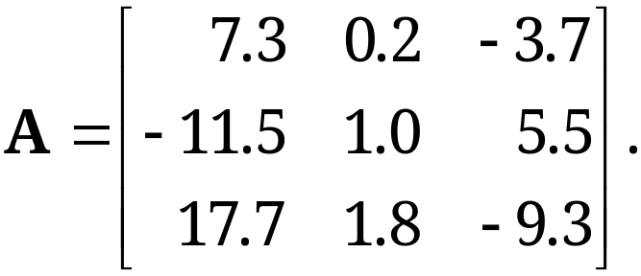
Diagonalization of a Matrix
Diagonalize
Solution.
The characteristic determinant gives the characteristic equation −λ³ −λ² + 12λ = 0. The roots (eigenvalues of A) are λ₁ = 3, λ₂ = −4, λ₃ = 0. By the Gauss elimination applied to (A − λI)x = 0 with λ = λ₁, λ₂, λ₃ we find eigenvectors and then X⁻¹ by the Gauss–Jordan elimination

Slide 10
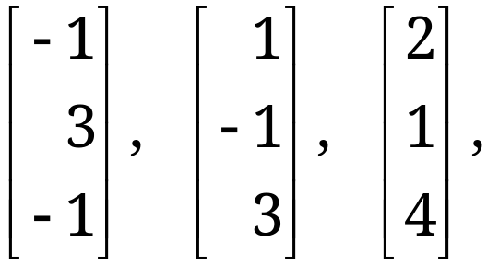
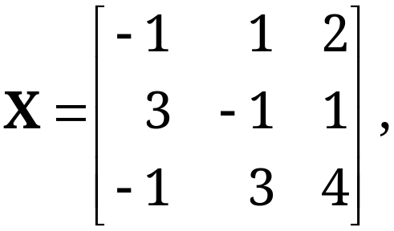
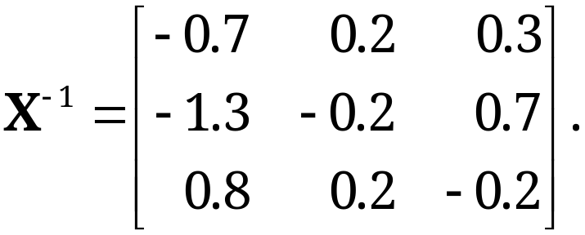
Diagonalization of a Matrix
Solution. (continued 1)
The results are

Slide 11
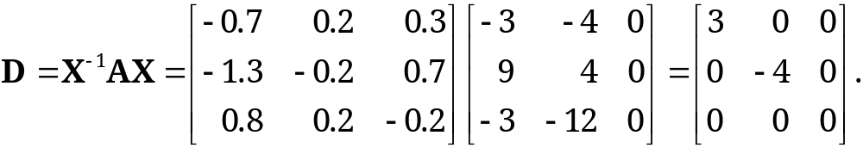
Diagonalization of a Matrix
Solution. (continued 2)
Calculating AX and multiplying by X⁻¹ from the left, we thus obtain

Slide 12
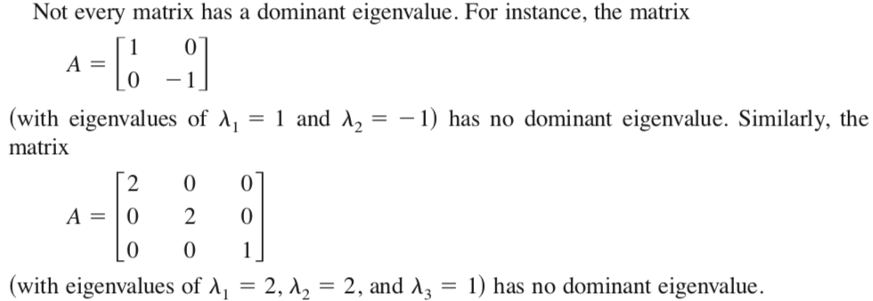
Dominant Eigenvalue
Let λ₁,λ₂,.....λ_{n} be eigen values of nxn matrix A
λ₁ is called dominant eigen value of A if
|λ₁| > |λ_{i}| for all i =2,3,....n
The eigen vectors corresponding to λ₁ are called dominant eigen vectors
Note : Not every matrix has dominant eigen value

Slide 13
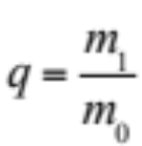
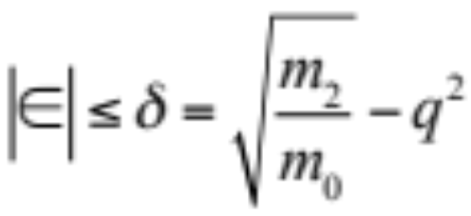
Rayleigh’s Quotient
Let A be an n x n real symmetric matrix
Let x(≠ 0) be any real vector with n components
Let y = Ax, m₀ = x^{T}x, m₁ = x^{T}y, m₂ = y^{T}y
Rayleigh Quotient
is an approximation for an eigenvalue λ of A, and if
we set q = λ – ε so that ε is error of q, then

Slide 14
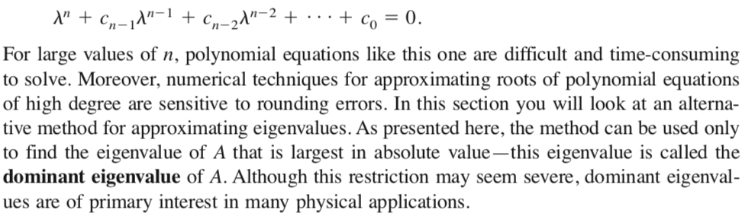
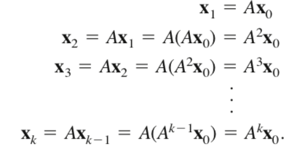
Power Method for approximating Eigenvalues

Slide 15
Power Method
To find the largest eigenvalues of a nxn matrix A. Assume that A has dominant eigenvalue
STEP 1 : Choose a column vector u_{o} = [1,1,.........1]^{T}
STEP 2 : Compute A * u_{o}
STEP 3 : Normalize the resulting vector obtained in step 2 by dividing each component by the largest in magnitude
STEP 4 : Repeat steps 2 and 3 until the change in normalizing factor is negligible
CONCLUSION :
The normalizing factor is an approximate value of eigen value
The final vector is the corresponding eigen vector

Slide 16
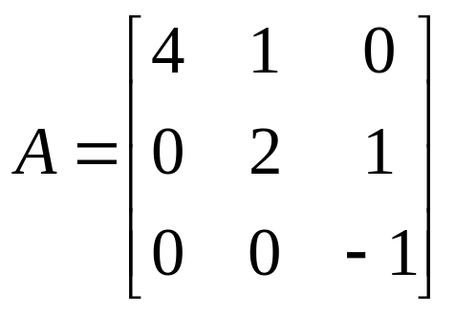
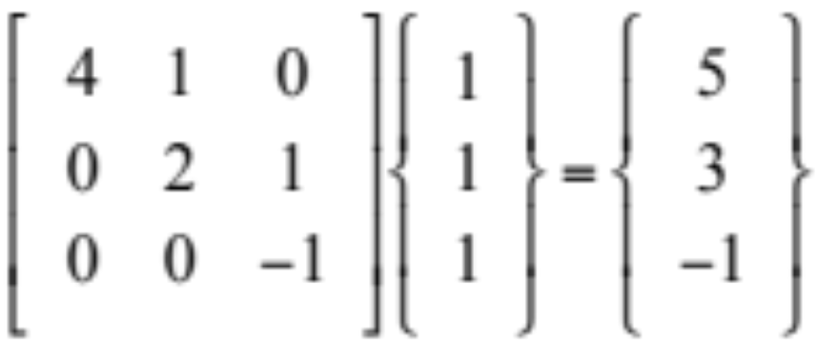
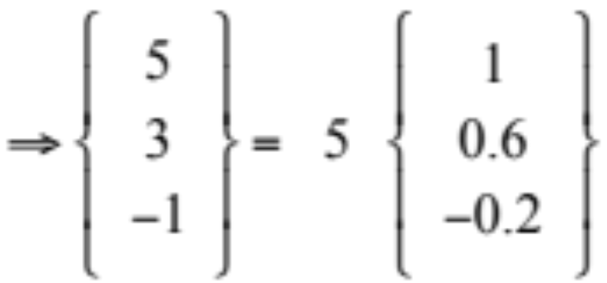
Power Method – Example
Find the dominant eigenvalues and corresponding
eigenvectors of the matrix
Step 1 : Choose column vector u_{o} = [ 1,1,1]^{T}
Step 2 :Multiply the matrix by the matrix [A] by u_{o} = y₁
Step 3 :Normalize the resulting vector obtained in step 2 by dividing each component by the largest in magnitude
u₁ = y₁ / 5 = [ 1, 0.6 , - 0.2 ]^{T} Normalizing factor m₁ = 5

Slide 17
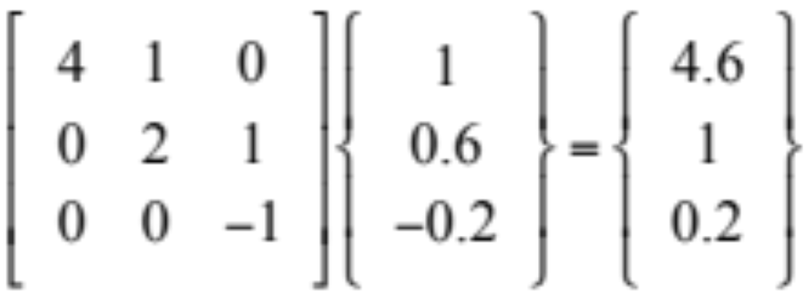
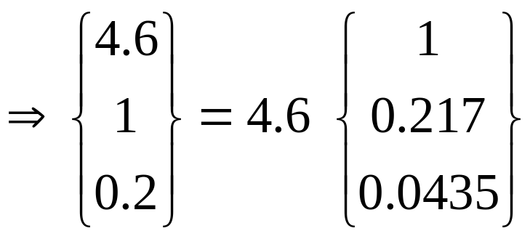
Power Method - Example
Step 4 :
u₂ = y₂ / 4.6 (normalizing factor m₂)

Slide 18
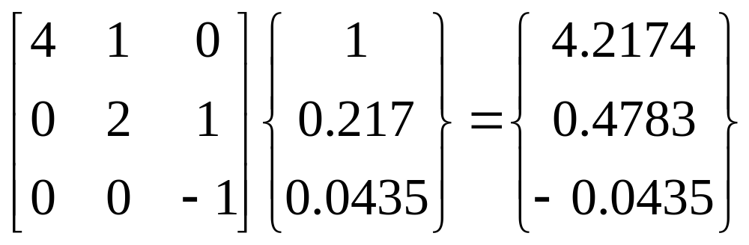
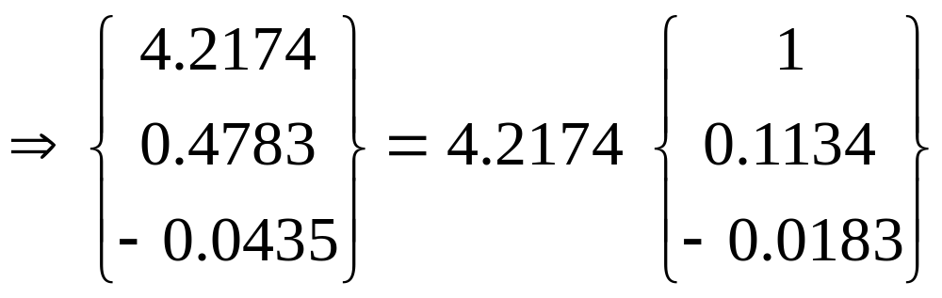
Power Method
Now Repeating steps 2 and 3
u₃ = y₃ / 4.2174 (normalizing factor m₃)

Slide 19
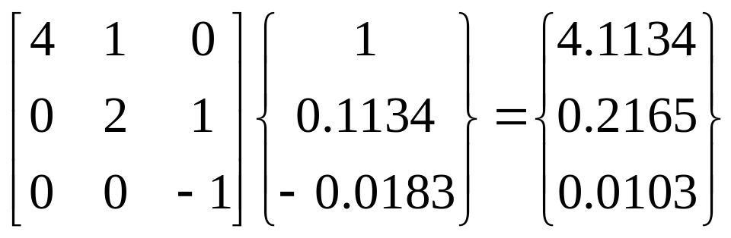
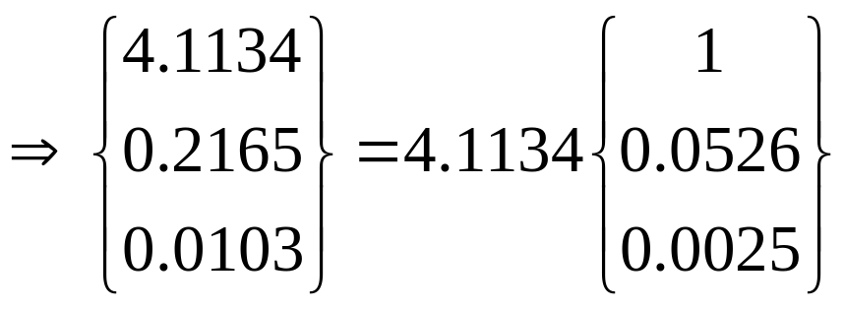
Power Method – Example
Continue the process
u₄ = y₄ / 4.1134 (normalizing factor m₄)
m₁ | m₂ | m₃ | m₄
5 | 4.6 | 4.2174 | 4.1134
Change in normalizing factor m_{i} ^{‘s} is now negligible
LARGEST Eigenvalue is m₄ = 4.1134
Corresponding Eigen vector u₄ = [1,0, 0]^{T}

Slide 20
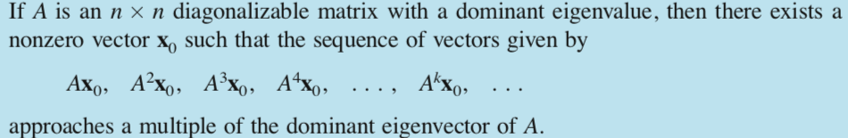

Convergence of Power Method
If the eigen values are ordered such that

Slide 21
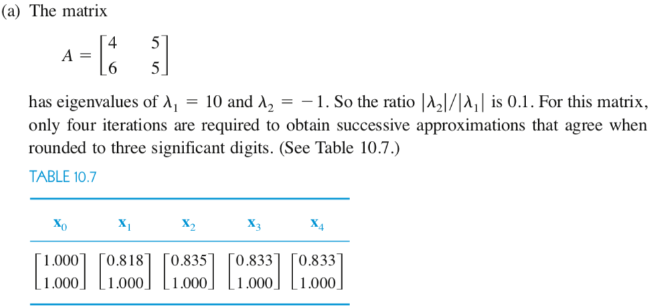
Convergence of Power Method

Slide 22
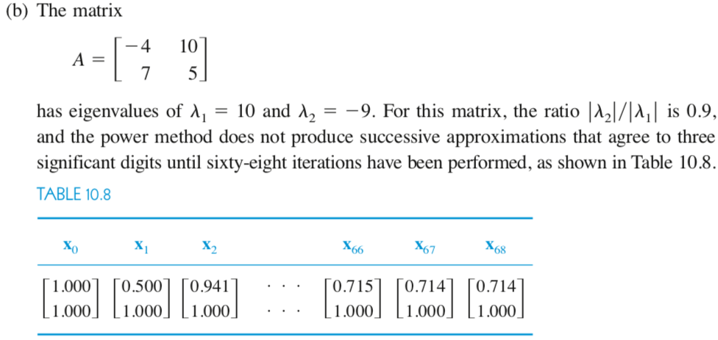
Convergence of Power Method

